Slide 1

JavaScript Chapter 08: Bult-in JavaScript Methods

Slide 2
Introduction
We have just covered most of the basic building blocks in JavaScript. Now it's time to look at some powerful built-in methods that will make your life easier that we haven't seen yet. Built-in methods are functionality that we get out of the box with JavaScript. We can use these methods without having to code them first. This is something we have done a lot already, for example, console.log() and prompt().
Many built-in methods belong to built-in classes as well. These classes and their methods can be used at any time because JavaScript has already defined them. These classes exist for our convenience, since they are very common things to need, such as the Date, Array, and Object classes.

Slide 3
Introduction
The ability to harness the capabilities that are already built into JavaScript can improve the effectiveness of the code, save time, and comply with various best practices for developing solutions. We are going to address some of the common uses for such functions, such as manipulating text, mathematical computations, dealing with date and time values, interactions, and supporting robust code. Here are the topics covered in this chapter:
Global JavaScript methods
String methods
Math methods
Date methods
Array methods
Number methods

Slide 4
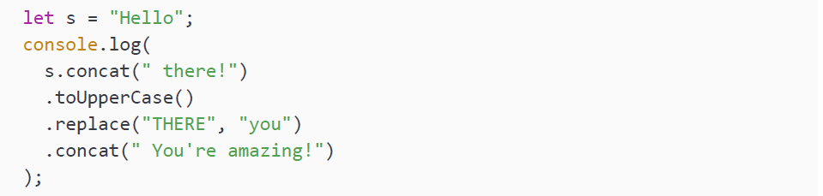
Introduction to built-in JavaScript methods
We have seen many built-in JavaScript methods already. Any method that we didn’t define ourselves is a built-in method. Some examples include console.log(), Math.random(), prompt(), and many more—think about methods on arrays for example.
The difference between a method and a function is that a function is defined anywhere in the script, and a method is defined inside a class. So methods are pretty much functions on classes and instances.
Methods can often be chained as well; this is only true for methods returning a result. The next method will then be performed on the result. So for example:

Slide 5
Introduction to built-in JavaScript methods
We create a variable, s, and we store Hello in there on the first line. Then we want to be logging something. This code has been divided over different lines for readability, but it's actually one statement. We first perform a concat() method on our s variable, which appends a string to our string. So after that first operation the value is Hello there!. Then we transform this to uppercase with the next method. At that point the value is HELLO THERE!. Then we proceed to replace THERE with you. After that, the value becomes HELLO you!. We then append a string to it again and finally the value will be logged:
We need to log or store the output in this example, because the original string value will not be updated by just calling methods on a string.

Slide 6
Global methods
The global JavaScript methods can be used without referring to the built-in object they are part of. This means that we can just use the method name as if it is a function that has been defined inside the scope we are in, without the "object" in front of it. For example, instead of writing:
You can also write:

Slide 7
Global methods
So, the Number can be left out, because isNaN is made globally available without referring to the class it belongs to (in this instance, the Number class). In this case, both of these console.log statements will log false (they are doing the exact same thing), because isNaN returns true when it isn't a number. And 7 is a number, so it will log false.
JavaScript has been built to have these available directly, so to achieve this, some magic is going on beneath the surface. The JavaScript creators chose the methods that they thought were most common. So the reasons why some of them are available as global methods and others are not might seem a bit arbitrary. It's just the choice of some very bright developers at a certain point in time.
We'll address the most common global methods below. We start with decoding and encoding URIs, escaped and unescaped, followed by parsing numbers, and finally evaluate.

Slide 8
Decoding and encoding URIs
Sometimes you will need to encode or decode a string. Encoding is simply converting from one shape to another. In this case we will be dealing with percent encoding, also called URL encoding. Before we start, there might be some confusion on the URI and URL meaning. A URI (uniform resource identifier) is an identifier of a certain resource. URL (uniform resource locator) is a subcategory of URI that is not only an identifier, but also holds the information on how to access it (location).
Let's talk about encoding and decoding these URIs (and also URLs, since they are a subset). An example of when you'd need this is when you are sending variables over the URL using the get method in a form. These variables that you are sending via the URL are called query parameters.
If something contains a space, this will be decoded, because you cannot use spaces in your URL. They will be converted to %20. The URL might look something like:
www.example.com/submit?name=maaike%20van%20putten&love=coding

Slide 9
Decoding and encoding URIs
All characters can be converted to some %-starting format. However, this is not necessary in most cases. URIs can contain a certain number of alphanumeric characters. The special characters need to be encoded. An example, before encoding, is:
https://www.example.com/submit?name=maaike van putten
The same URL after encoding is:
https://www.example.com/submit?name=maaike%20van%20putten
There are two pairs of encode and decode methods. We will discuss them and their use cases here. You cannot have a URI with spaces, so working with these methods is crucial in order to work with variables containing spaces.

Slide 10
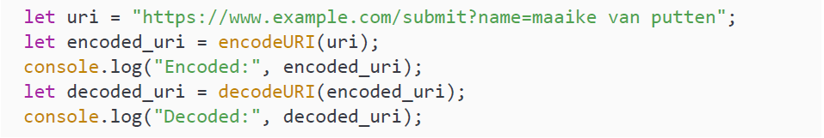
decodeUri() and encodeUri()
The decodeUri() and encodeUri() are actually not really encoding and decoding, they are more so fixing broken URIs. It is like the previous example with the spaces. This method pair is really good at fixing broken URIs and decoding them back into a string. Here you can see them in action:
And here is the output:

Slide 11
decodeUri() and encodeUri()
As you can see, it has replaced the spaces in the encoded version and removed them again in the decoded version. All the other characters get to stay the same—this encode and decode do not take special characters into account, and therefore leave them in the URI. Colons, question marks, equal signs, slashes, and ampersands can be expected.
This is great for fixing broken URIs, but it's actually a bit useless whenever you need to encode strings that contain any of these characters: / , ? : @ & = + $ #. These can be used in URIs as part of the URI and are therefore skipped. This is where the next two built-in methods come in handy.

Slide 12
decodeUriComponent() and encodeUriComponent()
So, the methods decodeURI() and encodeURI() can be very useful to fix a broken URI, but they are useless when you only want to encode or decode a string that contains a character with a special meaning, such as = or &. Take the following example:
https://www.example.com/submit?name=this&that=some thing&code=love
Weird value, we can agree on that, but it will demonstrate our problem. Using encodeURI on this will leave us with:
https://www.example.com/submit?name=this&that=some%20thing&code=love
There are actually 3 variables in here according to URI standards:
name (value is this)
that (value is some thing)
code (value is love)

Slide 13
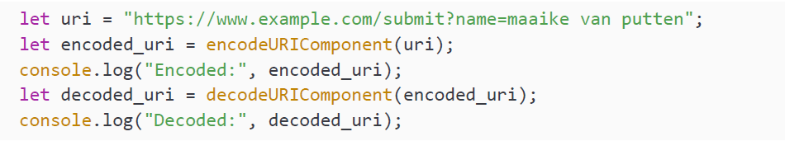
decodeUriComponent() and encodeUriComponent()
While we intended to send in one variable, name, with the value this&that=something&code=love. In this case, you will need decodeUriComponent() and encodeUriComponent(), because you would need the = and & in the variable part encoded as well. Right now, this is not the case and it will actually cause problems in interpreting the query parameters (the variables after the ?). We only wanted to send in one parameter: name. But instead we sent in three.
Let's have a look at another example. Here is what the example of the previous section would have done with this component encoding:

Slide 14
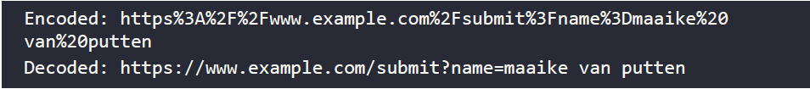
decodeUriComponent() and encodeUriComponent()
The resulting output is as follows
Clearly, you don't want this as your URI, but the component methods are useful to encode, for example, a URL variable. If the URL variable were to contain a special character, like = and &, this would change the meaning and break the URI if these characters don't get encoded.

Slide 15
Encoding with escape() and unescape()
These are still global methods available to do something similar to encode (escape)
and decode (unescape). Both methods are strongly discouraged to use and they
might actually disappear from future JavaScript versions or may not be supported by
browsers for good reasons.

Slide 16
Practice exercise 8.1
Output the decodeURIComponent() for the string How's%20it%20going%3F to the console. Also, encode the string How's it going? to be output into the console.
Create a web URL and encode the URI:
Add the strings as variables in the JavaScript code
Using encodeURIComponent() and decodeURIComponent() output the results into the console
Create a web URI with request parameters http://www.basescripts.com?=Hello World";
Encode and output the web URI into the console

Slide 17
Parsing numbers
There are different ways to parse strings to numbers. In many situations you will have
to translate a string to a number, for example reading input boxes from an HTML web
page. You cannot calculate with strings, but you can with numbers. Depending on
what exactly you need to do, you will need either one of these methods.

Slide 18
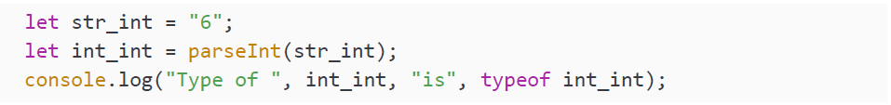
Making integers with parseInt()
With the method parseInt() a string will be changed to an integer. This method is part of the Number class, but it is global and you can use it without the Number in front of it. Here you can see it in action:
We start off with a string containing a 6. Then we convert this string to an integer using the parseInt method, and when we log the result, we will get in the console:

Slide 19
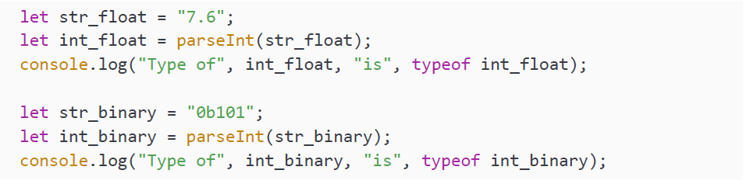
Making integers with parseInt()
You can see that the type has changed from string to number. At this point, you may wonder what will happen if parseInt() tries to parse other types of numbers, like string versions of floats or binary numbers. What do you think will happen when we do this?
This will log:

Slide 20
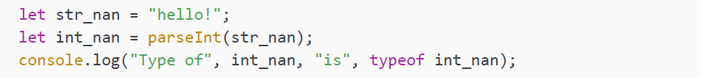
Making integers with parseInt()
Can you figure out the logic here? First of all, JavaScript doesn't like crashing or using errors as a way out, so it is trying to make it work to the best of its abilities. The parseInt() method simply stops parsing when it runs into a non-numeric character.
This is the specified behavior, and you need to keep that in mind while working with parseInt(). In the first case, it stops parsing as soon as it finds the dot, so the result is 7. And in the binary number case, it stops parsing as soon as it hits the b, and the result is 0. By now you can probably figure out what this does:
Since the first character is non-numeric, JavaScript will convert this string to NaN. Here is the result that you will get in the console:
So parseInt() can be a bit quirky, but it's very valuable. In the real world, it is used a lot to combine the input of users via web pages and calculations.

Slide 21
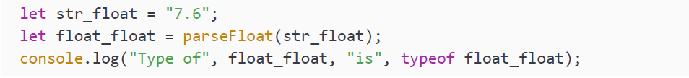
Making floats with parseFloat()
Similarly, we can use parseFloat() to parse a string to a float. It works exactly the same, except it can also understand decimal numbers and it doesn't quit parsing as soon as it runs into the first dot:
This will log:

Slide 22
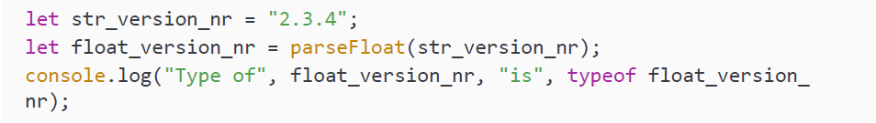
Making floats with parseFloat()
With the parseInt(), this value became 7, because it would stop parsing as soon as it finds a non-numeric character. However, parseFloat() can deal with one dot in the number, and the numbers after that are interpreted as decimals. Can you guess what happens when it runs into a second dot?
This will log:

Slide 23
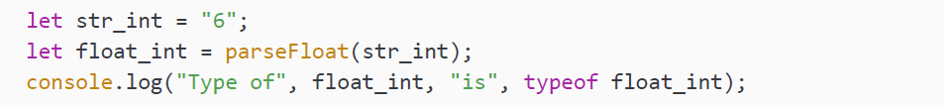
Making floats with parseFloat()
The strategy is similar to the parseInt() function. As soon as it finds a character it cannot interpret, a second dot in this case, it will stop parsing and just return the result so far. Then one more thing to note. It is not going to append a .0 to integers, so 6 is not going to become 6.0. This example:
Will log:

Slide 24
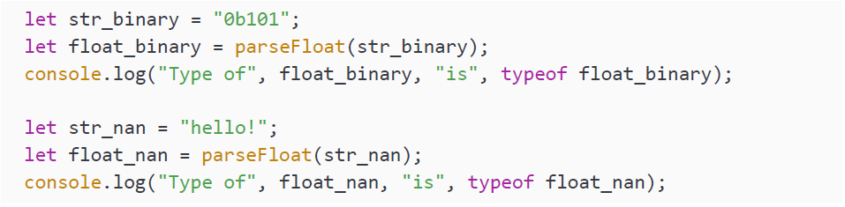
Making floats with parseFloat()
Lastly, the behavior for binary numbers and strings is the same. It is going to stop parsing as soon as it runs into a character it cannot interpret:
This will log:
You will use the parseFloat() whenever you need a decimal number. However, it will not work with binary, hexadecimal, and octal values, so whenever you really need to work with these values or integers you'll have to use parseInt().

Slide 25
Array methods
We have seen arrays already—they can contain multiple items. We have also seen
quite a few built-in methods on arrays, like shift() and push(). Let's look at a few
more in the following sections.

Slide 26
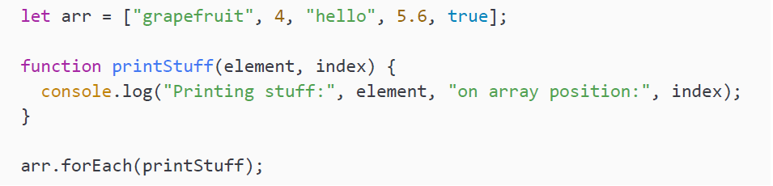
Performing a certain action for every item
There is a reason we are starting with this method. You might be thinking of loops at this point, but there is a built-in method that you can use to execute a function for every element in the array. This is the forEach() method. We mentioned this briefly in Chapter 6, Functions, but let's consider it in some more detail. It takes the function that needs to be executed for every element as input. Here you can see an example:

Slide 27
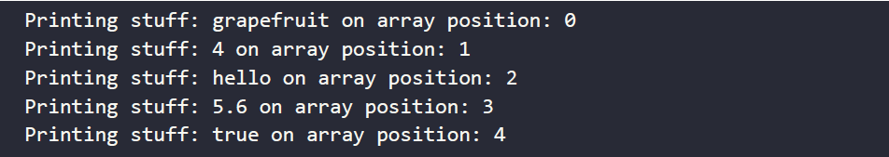
Performing a certain action for every item
This code snippet will write to the console:
As you can see, it called the printStuff() function for every element in the array. And we can also use the index, it is the second parameter. We don't need to control the flow of the loop here and we cannot get stuck at a certain point. We just need to specify what function needs to be executed for every element. And the element will be input for this function. This is used a lot, especially for a more functional programming style in which many methods get chained, for example, to process data.

Slide 28
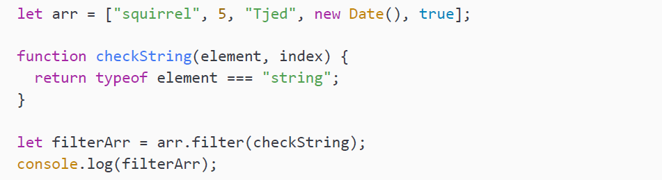
Filtering an array
We can use the built-in filter() method on an array to alter which values are in the array. The filter method takes a function as an argument, and this function should return a Boolean. If the Boolean has the value true, the element will end up in the filtered array. If the Boolean has the value false, the element will be left out. You can see how it works here:
This will log to the console:
It is important to realize that the original array has not changed, the filter() method returns a new array with the elements that made it through the filter. We capture it here in the variable filterArr.

Slide 29
Checking a condition for all elements
You can use the every() method to see whether something is true for all elements in the array. If that is the case, the every() method will return true, else it will return false. We are using the checkString() function and array from the previous example here:
This will log false, since not all elements are of type string in the array.

Slide 30
Replacing part of an array with another part of the array
The copyWithin() method can be used to replace a part of the array with another part of the array. In the first example we specify 3 arguments. The first one is the target position, to which the values get copied. The second one is the start of what to copy to the target position and the last one is the end of the sequence that will be copied to the target position; this last index is not included. Here we are only going to override position 0 with whatever is in position 3:
arr becomes:

Slide 31
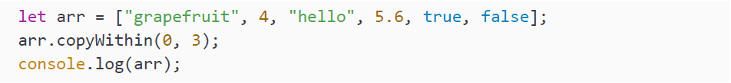
Replacing part of an array with another part of the array
If we specify a range with length 2, the first two elements after the starting position get overridden:
And now arr becomes:
We can also not specify an end at all; it will take the range to the end of the string:
This will log:
It is important to keep in mind that this function changes the content of the original array, but will never change the length of the original array.

Slide 32
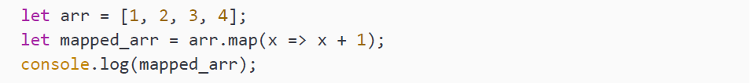
Mapping the values of an array
Sometimes you'll need to change all the values in an array. With the array map() method you can do just that. This method will return a new array with all the new values. You'll have to say how to create these new values. This can be done with the arrow function. It is going to execute the arrow function for every element in the array, so for example:
This is what the console output with the new mapped array looks like
Using the arrow function, the map() method has created a new array, in which each of the original array values has been increased by 1.

Slide 33
Finding the last occurrence in an array
We can find occurrences with indexOf() as we have seen already. To find the last occurrence, we can use the lastIndexOf() method on an array, just as we did for string.
It will return the index of the last element with that value, if it can find it at all:
This will log 2, because the index 2 holds the last bye variable. What do you think
you'll get when you ask for the last index of something that's not there?
That's right (hopefully)! It's -1.

Slide 34
Practice exercise 8.2
Remove duplicates from the array using filter() and indexOf(). The starting array is:
Using the array filter() method, this will create a new array using the elements that pass the test condition implemented by the function. The final result will be:

Slide 35
Practice exercise 8.2
Take the following steps:
Create an array of names of people. Make sure you include duplicates. The exercise will remove the duplicate names.
Using the filter() method, assign the results of each item from the array as arguments within an anonymous function. Using the value, index, and array arguments, return the filtered result. You can set the return value to true temporarily as this will build the new array with all the results in the original array.
Add a console.log call within the function that will output the index value of the current item in the array. Also add the value so you can see the results of the item value that has the current index number and the first matching result from the array's index value.
Using indexOf() the current value returns the index value of the item and applies the condition to check to see if it matches the original index value. This condition will only be true on the first result so all subsequent duplicates will be false and not get added to the new array. false will not return the value into the new array. The duplicates will all be false since the indexof() only gets the first match in the array.
Output the new, unique value array onto the console.

Slide 36
Practice exercise 8.3
Using the array map() method, update an array's contents. Take the following steps:
Create an array of numbers.
Using the array map method and an anonymous function, return an updated array, multiplying all the numbers in the array by 2. Output the result into the console.
As an alternative method, use the arrow function format to multiply each element of the array by 2 with the array map() method in one line of code.
Log the result onto the console.

Slide 37
String methods
We have worked with strings already and chances are that you have run into some
of the methods on strings by now. There are a few we didn't address specifically just
yet and we are going to discuss them in this section.

Slide 38
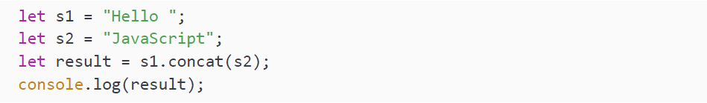
Combining strings
When you want to concatenate strings, you can use the concat() method. This does not change the original string(s); it returns the combined result as a string. You will have to capture the result in a new variable, else it will get lost:
This will log:

Slide 39
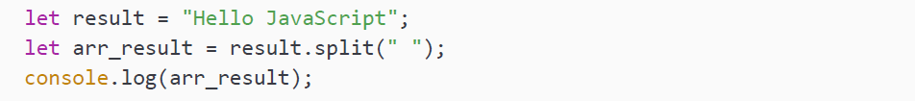
Converting a string to an array
With the split() method we can convert a string to an array. Again, we will have to capture the result; it is not changing the original string. Let's use the previous result containing Hello JavaScript. We will have to tell the split method on what string it should split. Every time it encounters that string, it will create a new array item:
This will log:

Slide 40
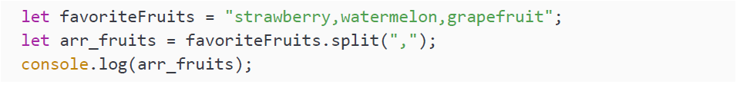
Converting a string to an array
As you can see, it creates an array of all the elements separated by a space. We can split by any character, for example a comma:
This will log:
It has now created an array with 3 items. You can split on anything, and the string you are splitting on is left out of the result.

Slide 41
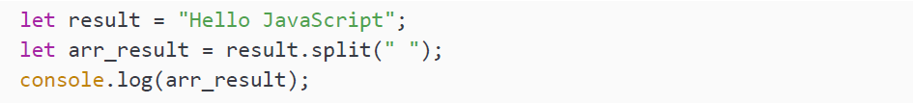
Converting an array to a string
With the split() method we can convert a string to an array. Again, we will have to capture the result; it is not changing the original string. Let's use the previous result containing Hello JavaScript. We will have to tell the split method on what string it should split. Every time it encounters that string, it will create a new array item:
This will log:

Slide 42
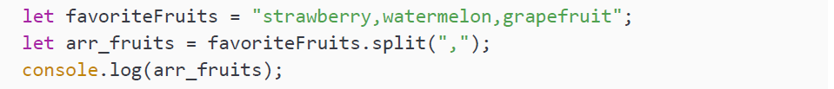
Converting an array to a string
As you can see, it creates an array of all the elements separated by a space. We can split by any character, for example, a comma:
This will log:
It has now created an array with 3 items. You can split on anything, and the string you are splitting on is left out of the result.

Slide 43
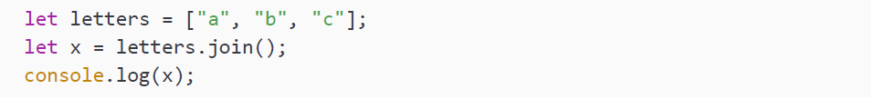
Converting an array to a string
With the join() method you can convert an array to a string. Here is a basic example:
This will log:

Slide 44
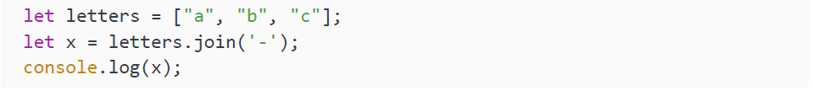
Converting an array to a string
The type of x is string. If you want something else other than a comma, you can specify that, like this:
This will use the – instead of the comma. This is the result:
This can be nicely combined with the split() method that we covered in the previous section, which does the reverse and converts a string into an array.

Slide 45
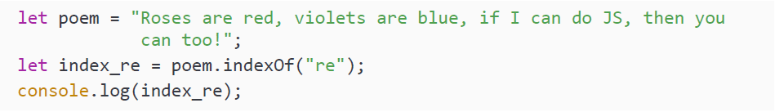
Working with index and positions
Being able to find out what index a certain substring is at within your string is very useful. For example, when you need to search for a certain word through the user input of a log file and create a substring starting at that index. Here is an example of how to find the index of a string. The indexOf() method returns the index, a single number, of the first character of the substring:

Slide 46
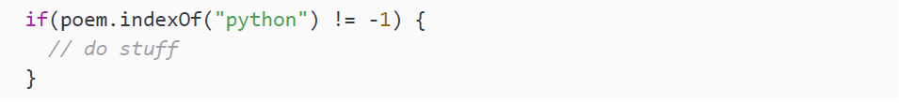
Working with index and positions
This is logging 7 to the console, because the first occurrence of re is in are, and the re begins at index 7. When it can't find an index, it will return -1, like this example:
It is logging -1 to indicate that the string we are searching for doesn't occur in the target string. Often you will write an if check to see whether it's -1 before dealing with he result. For example:

Slide 47
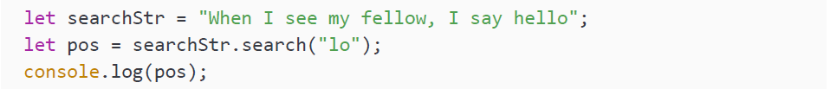
Working with index and positions
An alternative way of searching for a particular substring within a string is to use the search() method:
This will log 17, because that is the index of lo in fellow. Much like indexOf(), if it cannot find it, it will return -1. This is the case for this example:
search() will accept a regex format as input, whereas indexOf() just takes a string. indexOf() is faster than the search() method, so if you just need to look for a string, use indexOf(). If you need to look for a string pattern, you'll have to use the search() method.

Slide 48
Working with index and positions
If you are asking for the position of an index that is out of the range of the string, it will return an empty string, as is happening in this example:
This will log an empty line to the screen, and if you ask for the type of pos2, it will return string.

Slide 49
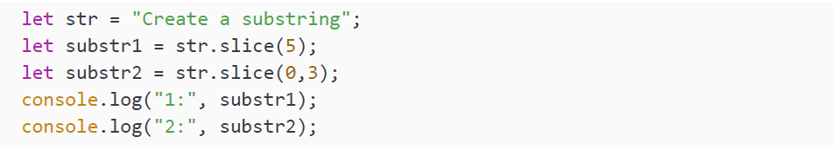
Creating substrings
With the slice(start, end) method we can create substrings. This does not alter the original string, but returns a new string with the substring. It takes two parameters, the first is the index at which it starts and the second is the end index. If you leave out the second index it will just continue until the end of the string from the start.
The end index is not included in the substring. Here is an example:

Slide 50
Creating substrings
This will log:
The first one only has one argument, so it starts at index 5 (which holds an e) and grabs the rest of the string from there. The second one has two arguments, 0 and 3. C is at index 0 and a is at index 3. Since the last index is not included in the substring, it will only return Cre.

Slide 51
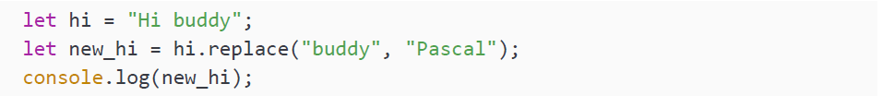
Replacing parts of the string
If you need to replace a part of the string, you can use the replace(old, new) method. It takes two arguments, one string to look for in the string and one new value to replace the old value with. Here is an example:
This will log to the console Hi Pascal. If you don't capture the result, it is gone, because the original string will not get changed. If the string you are targeting doesn't appear in the original string, the replacement doesn't take place and the original string will be returned:
This logs Hi buddy.

Slide 52
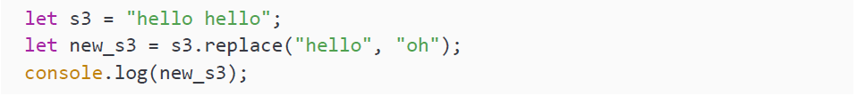
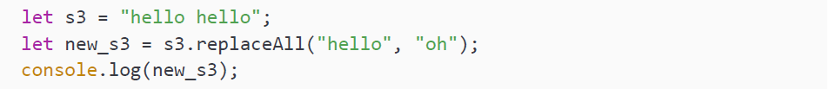
Replacing parts of the string
One last note here, it is only changing the first occurrence by default. So this example will only replace the first hello in the new string:
This logs oh hello. If we wanted to replace all the occurrences, we could use the replaceAll() method. This will replace all occurrences with the specified new string, like this:
This logs oh oh.

Slide 53
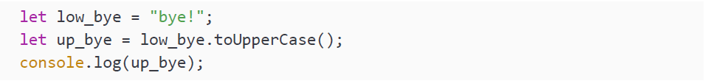
Uppercase and lowercase
We can change the letters of a string with the toUpperCase() and toLowerCase() built-in methods on string. Again, this is not changing the original string, so we’ll have to capture the result:
This logs:

Slide 54
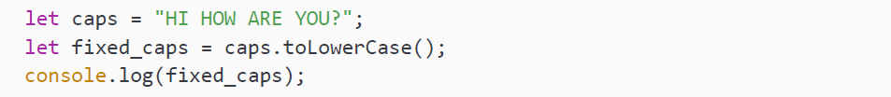
Uppercase and lowercase
It converts all the letters to uppercase. We can do the opposite with toLowerCase():
This logs:

Slide 55
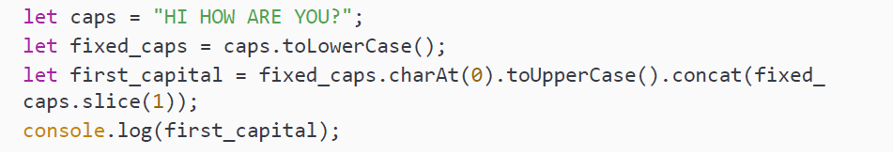
Uppercase and lowercase
Let's make it a bit more complicated and say that we'd like the first letter of the sentence to be capitalized. We can do this by combining some of the methods we have seen already right now:
We are chaining the methods here; we first grab the first character of fixed_caps with charAt(0) and then make it uppercase by calling toUpperCase() on it. We then need the rest of the string and we get it by concatenating slice(1).

Slide 56
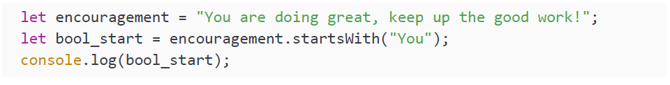
The start and end of a string
Sometimes you would want to check what a string starts or ends with. You’ve guessed it, there are built-in methods for this on string. We can imagine this chapter is tough to work through, so here is a little encouragement and an example at the same time:
This will log true to the console, because the sentence starts with You. Careful here, because it is case sensitive. So the following example will log false:

Slide 57
The start and end of a string
If you don't care about uppercase or lowercase, you can use the previously discussed toLowerCase() method here, so that it will not take uppercase or lowercase into account:
We are now converting the string to lowercase first, so we know we are only working with lowercase characters here. However, an important side note here is that this will affect performance for huge strings.
To end this section, we can do the same thing for checking whether a string ends with a certain string. You can see it in action here:
Since it doesn't end with Something else, it will return false.

Slide 58
Practice exercise 8.4
Using string manipulation, create a function that will return a string with the first letter of all the words capitalized and the rest of the letters in lowercase. You should transform the sentence thIs will be capiTalized for each word into This Will Be Capitalized For Each Word:
Create a string with several words that have letters with different cases, a mix of upper and lowercase words.
Create a function that gets a string as an argument, which will be the value that we will manipulate.
In the function first transform everything to lowercase letters.
Create an empty array that can hold the values of the words when we capitalize them.
Convert the phrase into words in an array using the split() method.
Loop through each one of the words that are now in the new array, so you can select each one independently. You can use forEach() for this.

Slide 59
Practice exercise 8.4
Using slice() isolate the first letter in each word, then transform it to uppercase. Again using slice(), get the remaining value of the word without including the first letter. Then concatenate the two together to form the word that is now capitalized.
Add the new capitalized word into the blank array that you created. By the end of the loop you should have an array with all the words as separate items in the new array.
Take the array of updated words and using the join() method, transform them back into a string with spaces between each word.
Return the value of the newly updated string with capitalized words that can then be output into the console.

Slide 60
Practice exercise 8.5
Using the replace() string method, complete this vowel replacer exercise by replacing the vowels in a string with numbers. You can start with this string:
And turn it into something like the following:

Slide 61

Practice exercise 8.5
Take the following steps:
Create the previously specified string, and convert it to lowercase.
Create an array containing the vowels: a, e, i, o, u.
Loop through each letter you have in the array, and output the current letter into the console so that you can see which letter will be converted.
Within the loop, using replaceAll() update each vowel substring with the index value of the letter from the vowel array.
Once the loop completes output the result of the new string into the console.

Slide 62
Number methods
Let's move on to some built-in methods on the Number object. We have seen a few
already, these are so popular that some of them have been made into global methods.

Slide 63
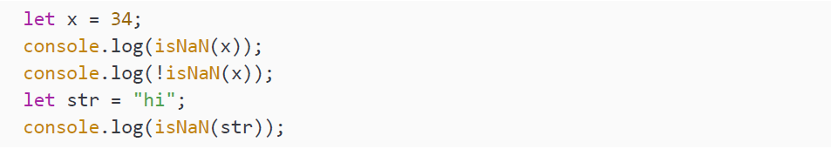
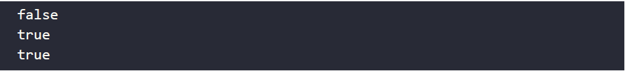
Checking if something is (not) a number
This can be done with isNaN(). We have seen this already when we talked about global methods, we can use this method without Number in front of it. Often you will want to do the opposite, you can negate the function with an ! in front of it:
This will log to the console:

Slide 64
Checking if something is (not) a number
Since x is a number, isNaN will be false. But this result negated becomes true, since x is a number. The string hi is not a number, so it will become false. And this one?
Some funky stuff is going on here, even though 5 is between quotation marks, JavaScript still sees that it's a 5 and it will log false. At this point, I'm sure you’d wish your partner, family, and coworkers are as understanding and forgiving as JavaScript.

Slide 65
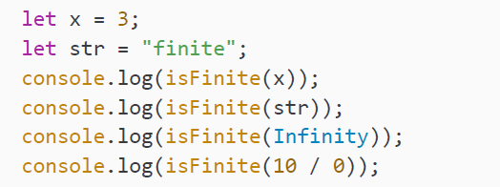
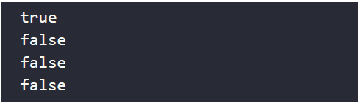
Checking if something is finite
By now you might be able to guess the name of the method on Number that checks whether something is finite. It is a very popular one and has been made into a global method as well, and its name is isFinite(). It returns false for NaN, Infinity, and undefined, and true for all other values:
This will log:
The only finite number in this list is x. The others are not finite. A string is a not a number and is therefore not finite. Infinity is not finite and 10 divided by 0 returns Infinity (not an error).

Slide 66
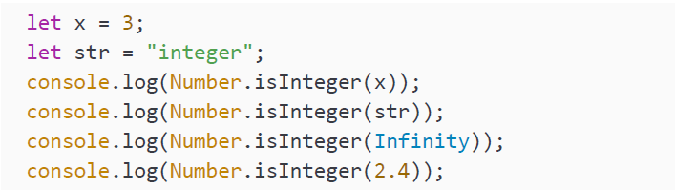
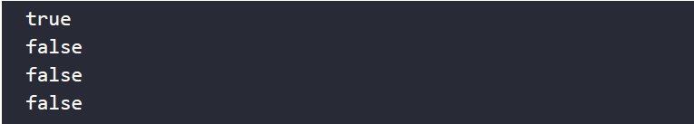
Checking if something is an integer
Yes, this is done with isInteger(). Unlike isNaN() and isFinite(), isInteger() has not been made global and we will have to refer to the Number object to use it. It really does what you think it would: it returns true if the value is an integer and false when it's not:
This will log:
Since the only integer in the list is x.

Slide 67
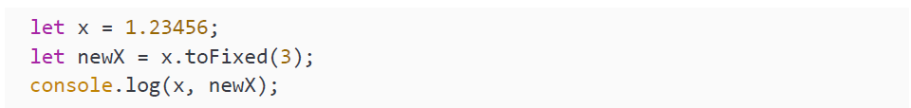
Specifying a number of decimals
We can tell JavaScript how many decimals to use with the toFixed() method. This is different from the rounding methods in Math, since we can specify the number of decimals here. It doesn't change the original value, so we'll have to store the result:
This will only leave two decimals, so the value of newX will be 1.23. It rounds the number normally; you can see this when we ask for one more decimal:
This logs 1.23456 1.235 as output.

Slide 68
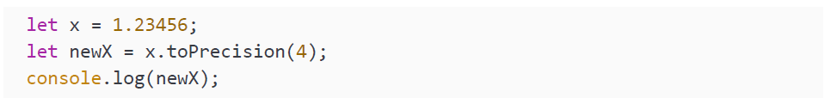
Specifying precision
methods in the Math class, since we can specify the total number of numbers to look at. This comes down to JavaScript looking at the total number of numbers. It is also counting the ones before the dot:
So the value of newX will be 1.2 here. And also here, it is rounding the numbers:
This will log 1.235.
Now, let's move on and talk about some related mathematical methods!

Slide 69
Math methods
The Math object has many methods that we can use to do calculations and operations
on numbers. We will go over the most important ones here. You can see all
the available ones when you use an editor that shows suggestions and options
during typing.

Slide 70
Finding the highest and lowest number
There is a built-in method max() to find the highest number among the arguments. You can see it here:
It logs 233, because that's the highest number. In a similar way, we can find the lowest number:
This will log 1, because that is the lowest number. If you try to do this with nonnumeric arguments, you will get NaN as a result:
It is not giving 3 as output, because it is not ignoring the text but concluding that it cannot determine whether hi should be higher or lower than 3. So it returns NaN instead.

Slide 71
Square root and raising to the power of
The method sqrt() is used to calculate the square root of a certain number. Here you can see it in action:
This will log 8, because the square root of 64 is 8. This method works just like the mathematics you learned in school. In order to raise a number to a certain power (baseexponent, for example 23), we can use the pow(base, exponent) function. Like this:
We are raising 5 to the power of 3 here (53), so the result will be 125, which is the result of 5*5*5.

Slide 72
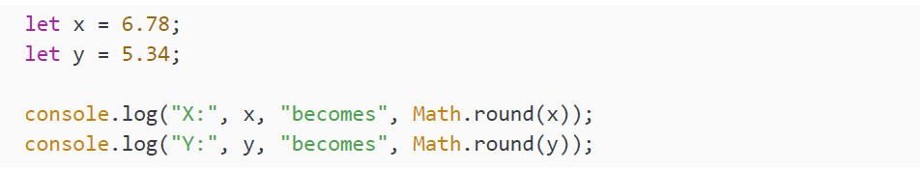
Turning decimals into integers
There are different ways to turn decimals into integers. Sometimes you will want to round a number. This you can do with the round() method:
This will log:

Slide 73
Turning decimals into integers
As you can see it is using normal rounding here. It is also possible that you don’t want to round down, but up. For example, if you need to calculate how many wood boards you need and you conclude that you need 1.1, 1 is not going to be enough to do the job. You'll need 2. In this case, you can use the ceil() method (referring to ceiling):
This will log:

Slide 74
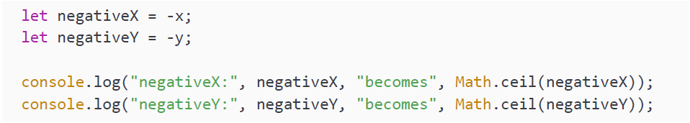
Turning decimals into integers
The ceil() method is always rounding up to the first integer it encounters. We have used this before when we were generating random numbers! Careful with negative numbers here, because -5 is higher than -6. This is how it works, as you can see in this example:
This will log:

Slide 75
Turning decimals into integers
The floor() method is doing the exact opposite of the ceil() method. It rounds down to the nearest integer number, as you can see here:
This will log: Again, careful with negative numbers here, because it can feel counterintuitive:
This logs:

Slide 76
Turning decimals into integers
And then one last method, trunc(). This gives the exact same result as floor() for positive numbers, but it gets to these results differently. It is not rounding down, it is simply only returning the integer part: This will log: When we use negative numbers for trunc() we can see the difference: So whenever you need to round down, you'll have to use floor(), if you need the integer part of the number, you'll need trunc().

Slide 77
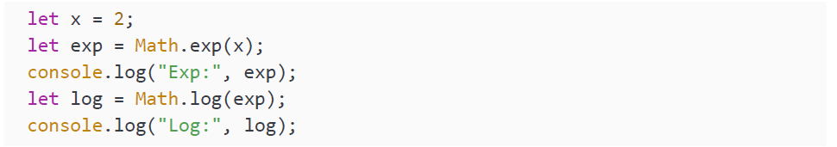
Exponent and logarithm
The exponent is the number to which a base is being raised. We use e (Euler’s number) a lot in mathematics, this is what the exp() method in JavaScript does. It returns the number to which e must be raised to get the input. We can use the exp() built-in method of Math to calculate the exponent, and the log() method to calculate the natural logarithm. You can see an example here:
This will log:
Don't worry if you can't follow along mathematically at this point. You'll figure this out whenever you'll need it for your programming.

Slide 78
Practice exercise 8.6
Experiment with the Math object with these steps:
Output the value of PI into the console using Math.
Using Math get the ceil() value of 5.7, get the floor() value of 5.7, get the round value of 5.7, and output it into the console.
Output a random value into the console.
Use Math.floor() and Math.random() to get a number from 0 to 10.
Use Math.floor() and Math.random() to get a number from 1 to 10.
Use Math.floor() and Math.random() to get a number from 1 to 100.
Create a function to generate a random number using the parameters of min and max. Run that function 100 times, returning into the console a random number from 1 to 100 each time.

Slide 79
Date methods
In order to work with dates in JavaScript we use the built-in Date object. This object
contains a lot of built-in functions to work with dates.

Slide 80
Creating dates
There are different ways to create a date. One way to create dates is by using the different constructors. You can see some examples here:
This will log the current date and time, in this case:

Slide 81
Creating dates
But, this way we are not using the built-in method, but the constructor. There is a built-in method, now(), that returns the current date and time, similar to what the no argument constructor does:
This will log the current time, represented in seconds since January 1st 1970. This is an arbitrary date representing the Unix epoch. In this case:

Slide 82
Creating dates
We can add 1,000 milliseconds to the Unix epoch time:
It will log:

Slide 83
Creating dates
JavaScript can also convert many string formats to a date. Always mind the order in which days and months of dates are presented in the date format and the interpreter of JavaScript. This can vary depending on the region:
This will log:

Slide 84
Creating dates
And lastly, you can also specify a certain date using the constructor:
This will log:
Please mind this very important detail here, the second parameter is the month. 0 is for January and 11 is for December.

Slide 85
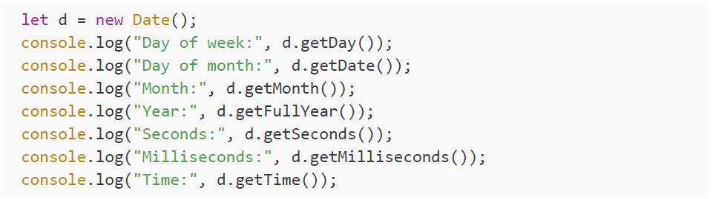
Methods to get and set the elements of a date
Now we have seen how to create dates, we'll learn how to get certain parts of dates. This can be done with one of the many get methods. Which you will use depends on the part you need:

Slide 86
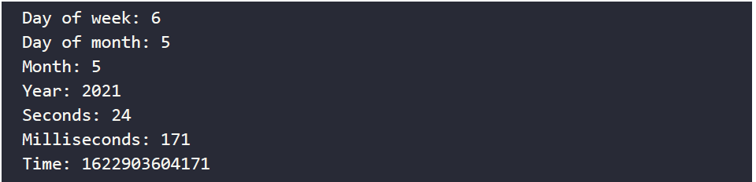
Methods to get and set the elements of a date
This will log right now:

Slide 87
Methods to get and set the elements of a date
This will lThe time is so high because it's the number of milliseconds since January 1st 1970. You can change the date in a similar way with a set method. Important to note here is that the original date object gets changed with these set methods:og right now:
We have changed the year of our date object to 2010. This will output:

Slide 88
Methods to get and set the elements of a date
We can also change the month. Let's add the below snippet to our change of the year code. This will change it to October. Please mind that while I'm doing this, I run the code again and again, so the minutes and smaller units of time will vary in the examples when I haven't set these yet:
It will log:

Slide 89
Methods to get and set the elements of a date
This is a weird one, in order to change the day, we have to call the setDate() method and not the setDay() method. There is no setDay() method, since the day of the week is deducted from the specific date. We cannot change that September 5th 2021 is a Sunday. We can change the number of days of the month though:
This will log:

Slide 90
Methods to get and set the elements of a date
We can also change the hours:
This will log:

Slide 91
Methods to get and set the elements of a date
Remember how JavaScript doesn't like to crash? If you call setHours() with a number higher than 24, it will roll over to the next date (1 per 24 hours) and after using the modulo operator, whatever is left over from hours % 24 will be the hours. The same process applies for minutes, seconds, and milliseconds.
The setTime() actually overrides the complete date with the inserted epoch time:
This will log:

Slide 92
Parsing dates
With the built-in parse() method we can parse epoch dates from strings. It accepts many formats, but again you will have to be careful with the order of days and months:
This will log:

Slide 93
Parsing dates
As you can see it ends with many zeros, because no time or seconds are specified in our string. And here is another example of a completely different format:
This will also log:
The input for the parse is ISO formats of dates. Quite a few formats can be parsed to string, but you'll have to be careful. The result might depend on the exact implementation. Make sure that you know what the format of the incoming string is, so that you don't confuse months and days, and make sure that you know the behavior of the implementations. This can only be done reliably if you know what the string format is. So for example when you need to convert data coming from your own database or website's date picker.

Slide 94
Converting a date to a string
We can also convert dates back to strings. For example with these methods:
This will log the day in written format:
This is another method that converts it differently:
It will log:

Slide 95
Practice exercise 8.7
Output the date with the full month name into the console. When converting to or from arrays, remember that they are zero-based:
Set up a date object, which can be any date in the future or past. Log the date out into the console to see how it is typically output as a date object.
Set up an array with all the named months of the year. Keep them in sequential order so that they will match the date month output.
Get the day from the date object value, using getDate().
Get the year from the date object value, using getFullYear().
Get the month of the date object value, using getMonth().
Set up a variable to hold the date of the date object and output the month using the numeric value as the index for the array month name. Due to arrays being zero-based and the month returning a value of 1-12, the result needs to be subtracted by one.
Output the result into the console.

Slide 96
Word scrambler
Create a function that returns a value of a word and scrambles the letter order with Math.random():
Create a string that will hold a word value of your choice.
Create a function that can intake a parameter of the string word value.
Just like an array, strings also have a length by default. You can use this length to set the loop maximum value. You will need to create a separate variable to hold this value as the length of the string will be decreasing as the loop continues.
Create an empty temporary string variable that you can use to hold the new scrambled word value.
Create a for loop that will iterate the number of letters within the string parameter starting at 0 and iterating until the original length value of the string is reached.
Continues on the other slide →

Slide 97
Word scrambler
Create a variable that will randomly select one letter using its index value, with Math.floor() and Math.random() multiplied by the current length of the string.
Add the new letter to the new string and remove it from the original string.
Using console.log() output the newly constructed string from the random letters and output to the console both the original string and the new one as the loop continues.
Update the original string by selecting the substring from the index value and adding it to the remaining string value from the index plus one onward. Output the new original string value with the removed characters.
As you loop through the content you will see a countdown of the remaining letters, the new scrambled version of the word as it is built, and the decreasing letters in the original word.
Return the final result and invoke the function with the original string word as an argument. Output this to the console.

Slide 98
Countdown timer
Create code for a countdown timer that can be executed in the console window, and will show the total milliseconds, days, hours, minutes, and seconds remaining until a target date is reached:
Create an end date that you want to count down to. Format it in a date type format within a string.
Create a countdown function that will parse the endDate() and subtract the current date from that end date. This will show the total in milliseconds. Using Date.parse() you can convert a string representation of a date to a numeric value as a number of milliseconds since January 1, 1970, 00:00:00 UTC.
Once you have the total milliseconds, to get the days, hours, minutes, and seconds you can take the following steps:
To get days you can divide the number of milliseconds in a date, removing the remainder with Math.floor().
To get hours you can use modulus to capture just the remainder once the total days are removed.
To get minutes you can use the value of milliseconds in a minute and using the modulus capture the remainder.
Do the same for seconds by dividing the number by seconds in milliseconds and getting the remainder. If you use Math.floor() you can round down removing any remaining decimal places that will be shown in the lower values.
Continues on the other slide →

Slide 99
Countdown timer
Return all the values within an object with property names indicating what the unit of time the values refer to.
Create a function to use a setTimeout() to run the update() function every second (1,000 milliseconds). The update() function will create a variable that can temporarily hold the object return values of countdown(), and create an empty variable that will be used to create the output values.
Within the same function, using the for loop get all the properties and values of the temp object variable. As you iterate through the object update the output string to contain the property name and property value.
Using console.log(), print the output result string into the console.

Slide 100
Self-check quiz
Which method will decode the following?
decodeURIComponent(e)
e.decodeUriComponent()
decoderURIComponent(c)
decoderURIComponent(e)

Slide 101
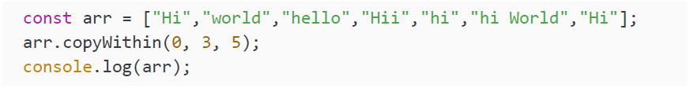
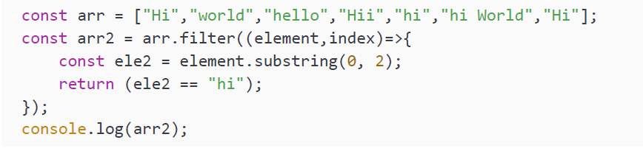
Self-check quiz
What will be output into the console from the following syntax?
What is the result of the below code in the console?
What is the result of the below code in the console?

Slide 102
Summary
In this chapter we have dealt with many built-in methods. These are methods that are handed to us by JavaScript and that we can use for things that we'll often need. We went over the most used global built-in methods, which are so common they can be used without being prepended by the object they belong to.
We also discussed array methods, string methods, number methods, math methods, and date methods. You'll find yourself using these methods a lot and chaining them (whenever they return a result) when you get more comfortable with JavaScript.
Now we've become familiar with many of JavaScript's core features, we'll spend the next couple of chapters diving into how it works alongside HTML and the browser to bring web pages to life!

